Slide 1
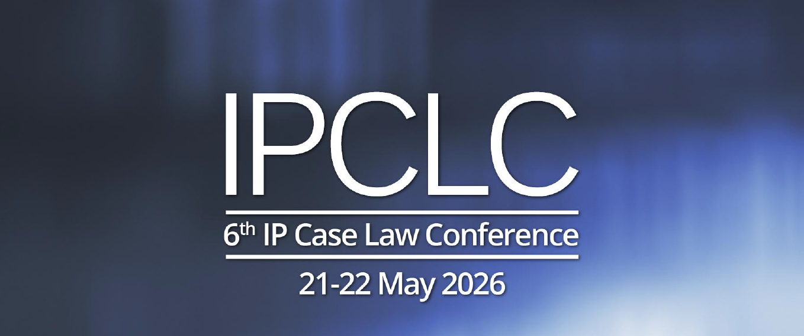
Leveraging domain names in trade mark disputes
Susana Fernández Martín
Head of IP strategy at INDITEX

Slide 2
Domain name: combination of typographical characters corresponding to one or several numeric IP addresses that are used to identify a particular web page or set of web pages on the internet.
Domain names functions as an ‘address’ for referring to a specific location on the internet or an email address.
The introduction of the Domain Name System (DNS) in 1983 enabled a scalable, distributed way to organize and access websites.
Some jurisdictions protect domain names as business identifiers
CHALLENGES

Slide 3
Article 8(4) EUTMR :
Upon opposition by the proprietor of a non-registered trade mark or of another sign used in the course of trade of more than mere local significance, the trade mark applied for shall not be registered where and to the extent that, pursuant to the Union legislation or the law of the Member State governing:
  rights to that sign were acquired prior to the date of application for registration of the EU trade mark, or the date of the priority claimed for the application for registration of the EU trade mark;
  (b) that sign confers on its proprietor the right to prohibit the use of a subsequent trade mark.

Slide 4
Assess if the claimed earlier rights fulfil the following cumulative requirements :
  1.- The existence of an earlier right:
  prior to the contested trade mark’s date of application for registration
  conferring on its proprietor the right to prohibit the use of a subsequent trade mark according to national law;
  2.- The use of the sign in the course of trade of more than mere local significance according to European standards.
The ratio legis of the requirement is to prevent minor rights from standing in the way of a European Union trade mark.

Slide 5
DECISION of the Fifth Board of Appeal of 8 March 2017
GM Holdings Co., Ltd.
Cellap Laboratoire S.A.
Article 8(4) EUTMR
Cellapy
(word mark)
The trade names CELLAP + CELLAP LABORATOIRE SA used in the course of trade in France
The company name CELLAP LABORATOIRE SA
The domain name cellap.ch + cellap.com used in the course of trade in France in respect
The signboard CELLAP SHOP FR used in the course of trade in France
in respect of: Cosmetic products.
Class 3 –
Shampoos; hair rinses (shampoo-conditioners); hair conditioners; cosmetic preparations for baths; facial washes; body oils; liquid bath soaps; cosmetics; lipsticks; make-up; eye lotions; skin lotions; cosmetic lip care preparations; sun-block lotions; oils for cosmetic purposes; cleansing creams [cosmetic]; mask pack for cosmetic purposes; cosmetic kits; cosmetic products for the face and body.

Slide 6
DECISION of the Second Board of Appeal of 5 October 2021
Sociedade Francisco Manuel Dos Santos, B.V.
Medical Innovation Developpement
Article 8(4) EUTMR
mid-med.com
non-registered domain name used in the course of trade in France and the United Kingdom in connection with the following activities:
  Medical and surgical apparatus and instruments; online promoting, marketing and retailing of medical and/or surgical apparatus, instruments and services ; research services and studies in the field of health, medicine and surgery; providing information, advice and consulting in the field of health, medicine, surgery, and for the use of medical and/or surgical apparatus and instruments
Class 44 –
Medical services; advisory services relating to health; medical services; health clinic services; providing health information; health centers; health clinic services [medical]; information services relating to health care.

Slide 7
Article L. 711-4 of France's Intellectual Property Code (IPC) provides that:
"Signs may not be adopted as trademarks where they infringe earlier rights in, inter alia/particularly , (…)
  a) an earlier mark that is registered or is well known within the meaning of Article 6bis of the Paris Convention for the Protection of Industrial Property;
  b) a name or style of a corporate entity, where there is a likelihood of confusion in the public mind;
  c) a trade name or trade sign known throughout the national territory, where there is a likelihood of confusion in the public mind;
  d) a protected appellation of origin or geographical indication;
  e) a copyright;
  f) resulting from a protected design;
  g) the personality rights of a third party, including his or her patronym, pseudonym or image;
  h) the name, image or reputation of a territorial community."
The provisions thereof are now included in the new Article L711-13 of Ordinance No 2019-1169 of 13 November 2019,effective as of 10 December 2020which reads:
Cannot be validly registered and, if it is registered, is likely to be declared void a trade mark infringing previous rights having effect in France, in particular: (…);
  4° A trade name, a sign or a domain name, the scope of which is not only local, if there is a risk of confusion in the mind of the public.

Slide 8
THANK YOU
Susana Fernández Martín
Head of IP strategy at INDITEX
susanafm@inditex.com

